Slide 1
M6

Slide 2
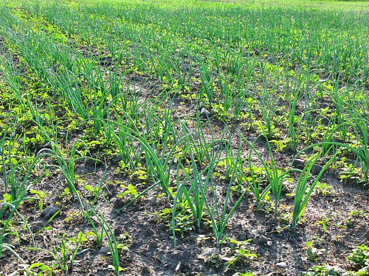
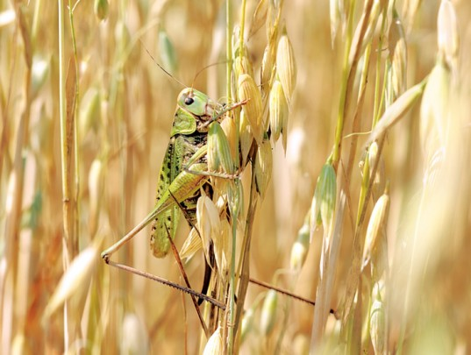
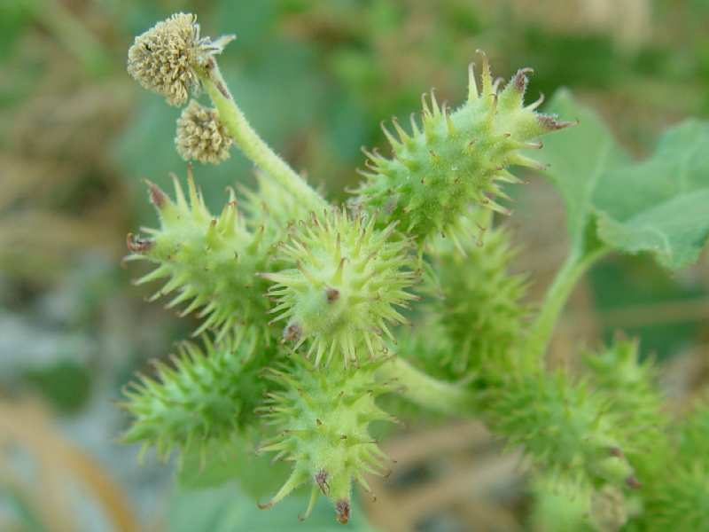
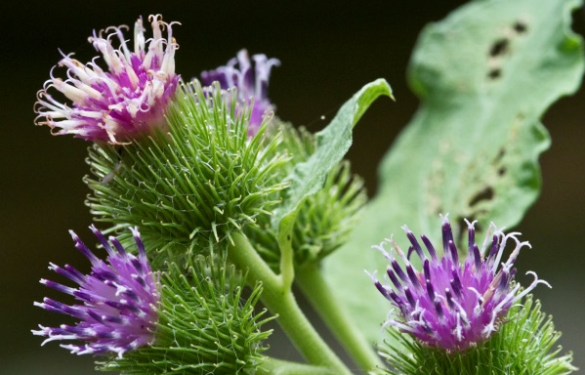
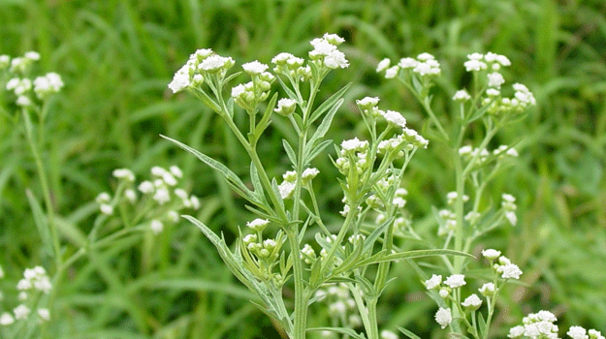
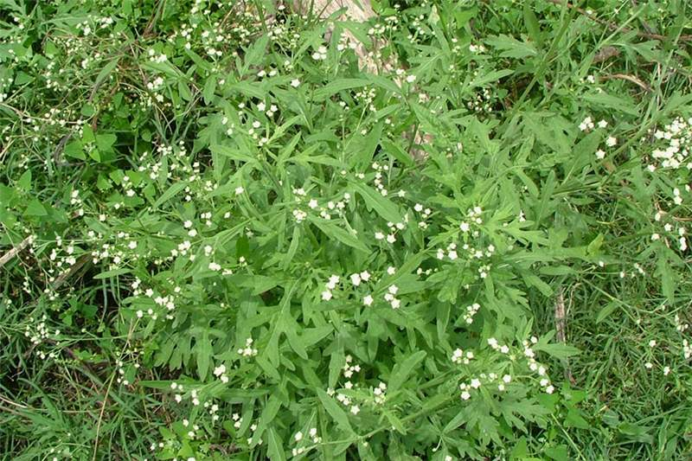
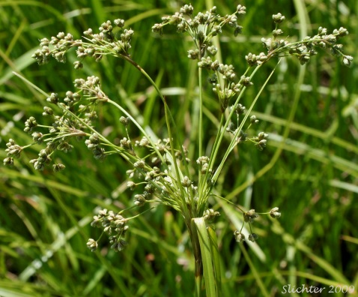
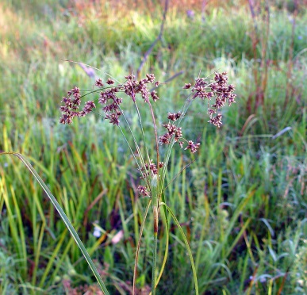
Crop Protection Management :
Field crops are infested by a large number of weeds, insect pests and diseases.
Unwanted plants
If weeds and pests are not controlled at the appropriate time then they can damage the crops so much that most of the crop is lost.
Weeds are unwanted plants in the cultivated field.
For example,
Xanthium (gokhroo),
Parthenium (gajar ghas),
Cyperinus rotundus (motha).
They compete for food, space and light.
Weeds take up nutrients and reduce the growth of the crop.
Therefore, removal of weeds from cultivated fields during the early stages of crop growth is essential for a good harvest.

Slide 3
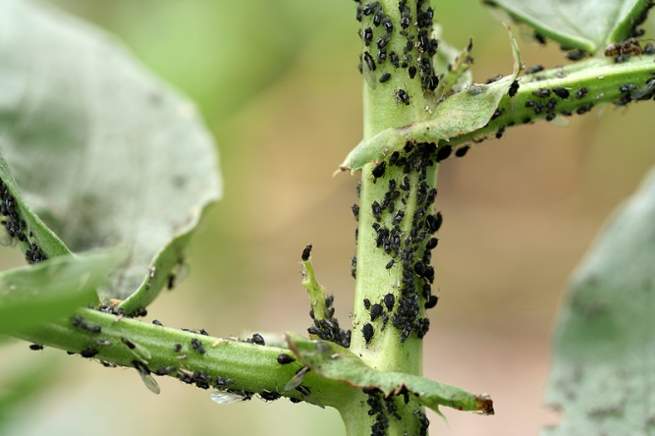
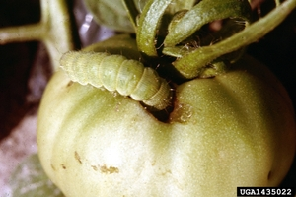
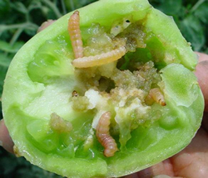
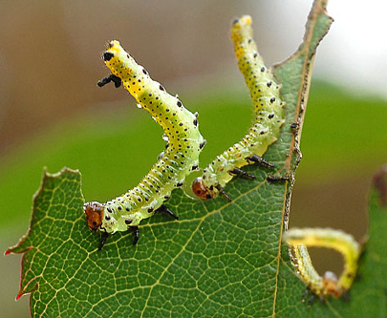
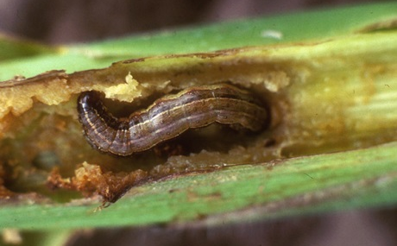
Crop Protection Management :
Generally insect pests attack the plants in three ways:
they cut the root, stem and leaf,
they suck the cell sap from various parts of the plant, and
they bore into stem and fruits.
Mixture of water and minerals.
They thus affect the health of the crop and reduce yields.
Diseases in plants are caused by pathogens such as bacteria, fungi and viruses.
Disease causing organisms
These pathogens can be present in and transmitted through the soil, water and air.

Slide 4
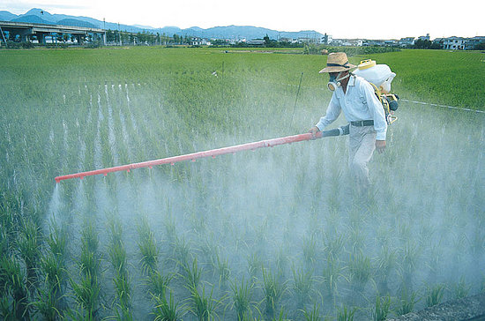
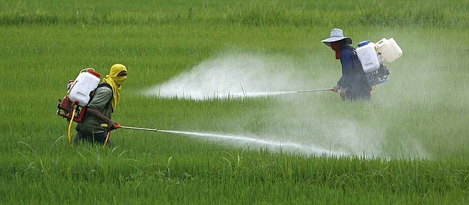
Crop Protection Management :
Weeds, insects and diseases can be controlled by various methods.
One of the most commonly used methods is the use of pesticides, which include herbicides, insecticides and fungicides.
These chemicals are sprayed on crop plants or used for treating seeds and soil.
However, excessive use of these chemicals creates problems, since they can be poisonous to many plant and animal species and cause environmental pollution.

Slide 5
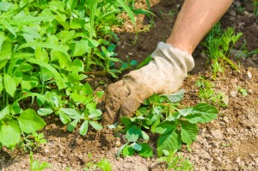
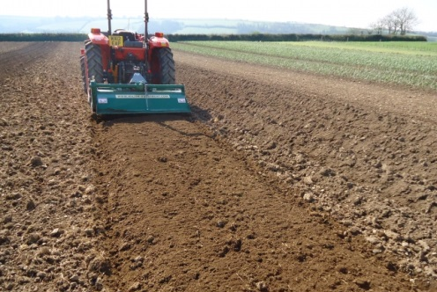
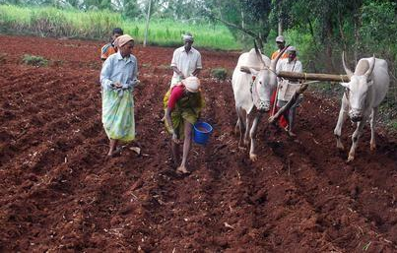
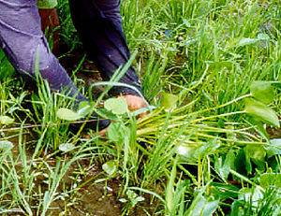
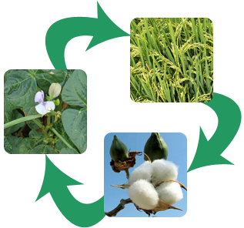
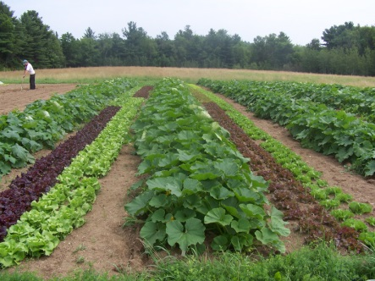
Crop Protection Management :
Weed control methods also include mechanical removal.
Preventive methods such as proper seed bed preparation, timely sowing of crops, intercropping and crop rotation also help in weed control.
Some other preventive measures against pests are the use of resistant varieties, and summer ploughing, in which fields are ploughed deep in summers to destroy weeds and pests.

Slide 6
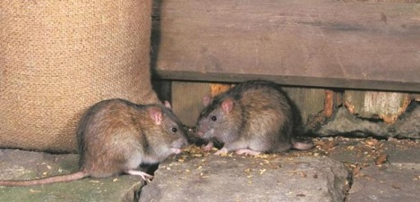
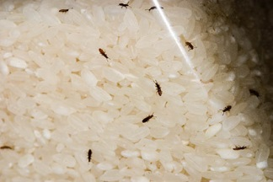
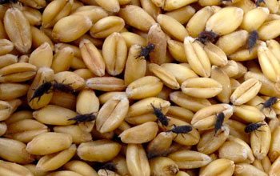
Storage of grains :
Storage losses in agricultural produce can be very high.
Factors responsible for such losses are
Biotic
Abiotic
Insects, rodents fungi, mites and bacteria,
Inappropriate moisture and temperatures in the place of storage.
These factors cause degradation in quality, loss in weight, poor germinability, discolouration of produce, all leading to poor marketability.
Germination of seeds

Slide 7
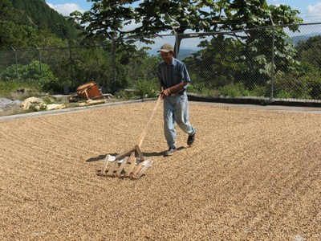
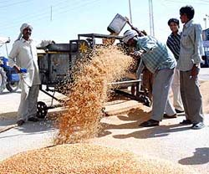
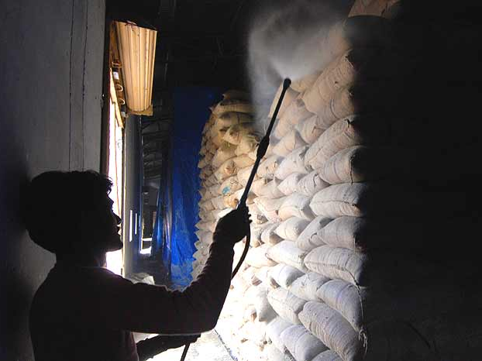
Storage of grains :
These factors can be controlled by proper treatment and by systematic management of warehouses.
Preventive and control measures are used before grains are stored for future use.
Gowdowns
They include strict cleaning of the produce before storage.
Proper drying of the produce first in sunlight and then in shade.
Fumigation using chemicals that can kill pests.

